Slide 1
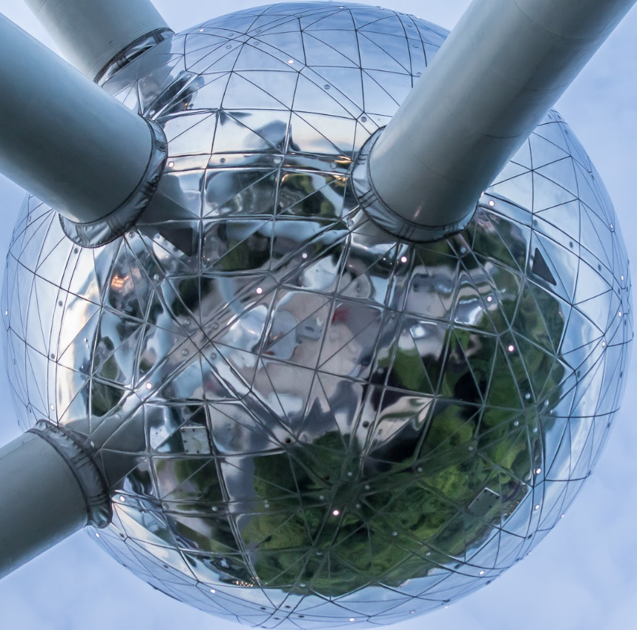
Applied Data Science Capstone "The Battle of Neighborhoods"
This presentation is a part of the final project for the Coursera's IBM Data Science Professional Certificate.
by Malgorzata Szoc, 12th of Feb 2021

Slide 2
Summary
Introduction (Business Problem)
Data
Methodology
Results
Discussion
Conclusion

Slide 3
Introduction (Business Problem)
In this project I’m going to segment and cluster Brussels-Capital Region¹ in order to help expats choose the best place to settle in. Brussels, officially the Brussels-Capital Region, is a region of Belgium comprising 19 municipalities, including the City of Brussels, which is the capital of Belgium. I will be using the term “Brussels” when I mean Brussels-Capital Region, and the term “City of Brussels”, when I mean one of the 19 municipalities being also the capital of Belgium.
Brussels is a very popular destination for expats². More often than not, they move to Brussels looking for better working and living conditions than the ones they can find in their own country. Why is it so? Brussels hosts several international institutions. Think about European Union institutions³ such as European Commission, Council of the European Union, European Council and European Parliament. The North Atlantic Treaty Organization headquarters⁴ are located in Brussels. As well as numerous multinational groups headquarters and subsidiaries.

Slide 4
Introduction (Business Problem)
The number of expats in Brussels is estimated5 to be 220,000 including 40,000 employees of European Union institutions and about 24,000 journalistes, lobbyists and diplomats gravitating around them. The number of NATO related workers is estimated to be 4,000.
The population of expats is diversified due to numerous factors, such as country of origin, income, age, marital status: are they single, married with children, what is the number and the age of children? In this study, I will segment and cluster the Brussels-Capital Region, to help expats choose the best place for living. It means that I will present different clusters with their majors characteristics and it will be up to expats themselves to perform an informed choice depending on their various expectations.

Slide 5
Introduction (Business Problem) - References
[1] https://en.wikipedia.org/wiki/Brussels
[2] https://en.wikipedia.org/wiki/Expatriate “An expatriate (often shortened to expat) is a person residing in a country other than their native country. In common usage, the term often refers to professionals, skilled workers, or artists taking positions outside their home country, either independently or sent abroad by their employers, which can be companies, universities, governments, or non-governmental organisations.”
[3] https://en.wikipedia.org/wiki/Brussels_and_the_European_Union “Brussels (Belgium) is considered the de facto capital of the European Union, having a long history of hosting a number of principal EU institutions within its European Quarter. The EU has no official capital, and no plans to declare one, but Brussels hosts the official seats of the European Commission, Council of the European Union, and European Council, as well as a seat (officially the second seat but de facto the most important one) of the European Parliament.”
[4] https://en.wikipedia.org/wiki/NATO_headquarters “The North Atlantic Treaty Organization is headquartered in a complex in Haren, part of the City of Brussels municipality of Belgium.”
[5] https://www.beci.be/les-expats-a-bruxelles-des-attentes-a-satisfaire/ (in French)

Slide 6
Data
As explained in the Introduction, Brussels-Capital Region is made up of 19 municipalities, including the City of Brussels, the capital of Belgium. Remember that I use the term “Brussels” when I mean Brussels-Capital Region.
Note: I was hesitating a lot about taking municipality as the basis for the project. Indeed, the first question that comes to mind is if the segmentation by municipality is not a too big subdivision to be suitable to point out main characteristics of it. At the beginning of the project I considered using a smaller subdivision such as a neighborhood - “quartier” in French - for which I found the necessary data on the website: https://monitoringdesquartiers.brussels/ .

Slide 7
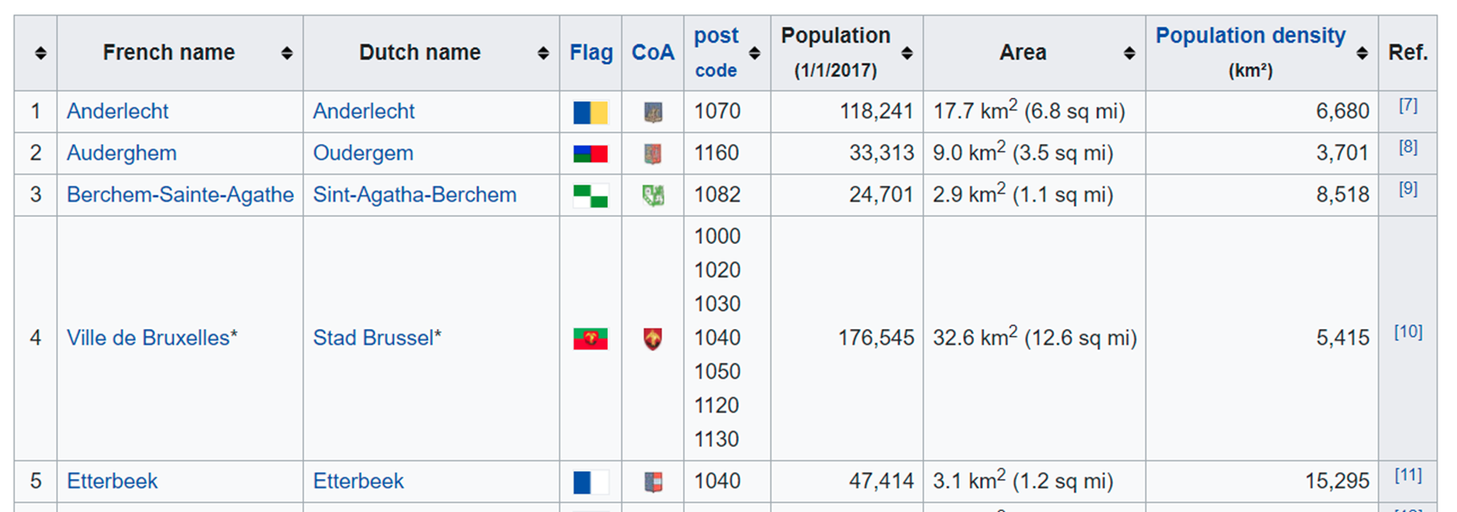
Data
Finally I went back to the idea of using larger divisions such as municipality. Data over municipalities in Brussels is easily available. In this project I took advantage of BeautifulSoup library to scrap a Wikipedia page containing a table of 19 municipalities in Brussels: https://en.wikipedia.org/wiki/List_of_municipalities_of_the_Brussels-Capital_Region.

Slide 8
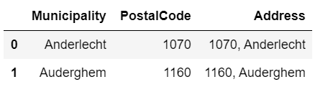
Data
The data from the previous slide was the starting point to prepare a file to be used as input for geopy and Nominatim service in order to get latitude and longitude for each municipality.
The “Address” column has been added that was a concatenation of postal code and municipality name so that Nominatim can geolocate every place without ambiguity.

Slide 9
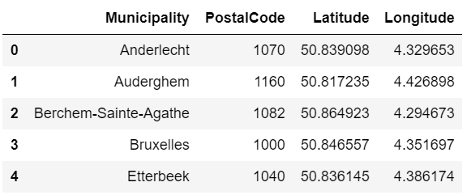
Data
After geocoding with Nominatim and some data cleaning, I ended up with the file to be used in Foursquare API to get venues in each municipality.

Slide 10
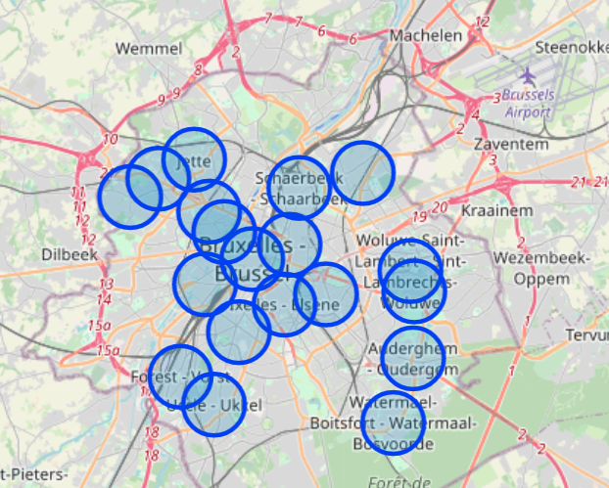
Methodology
The geopy library and Nominatim service have been used to get coordinates of Brussels-Capital Region and the folium library was used to display a map with municipalities as markers on the map. The folium.Circle has been used instead of folium.CircleMarker in order to visualize the radius in meters rather than in pixels as it gives us a feeling about overlapping areas.

Slide 11
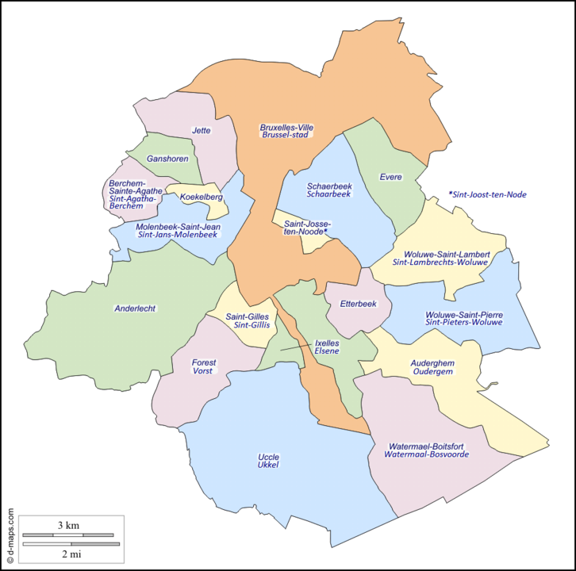
Methodology
As you can see on the image below, the territorial division of Brussels into 19 municipalities is quite heterogeneous. Areas differ very much in form and size.

Slide 12

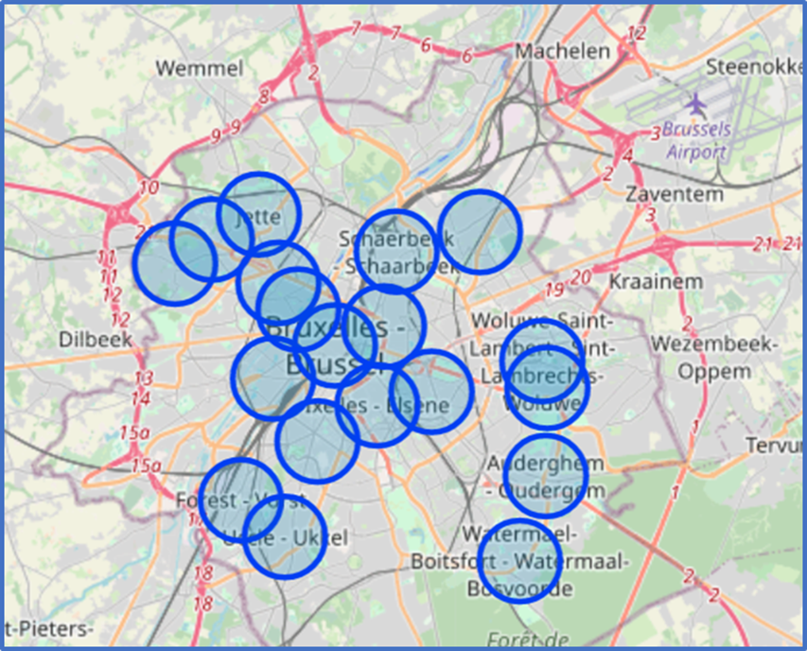
Methodology
We are facing here a difficult choice of the circle radius because its value will be used later on to get venues in municipalities from Foursquare API.
We understand here, that in fact, we are not going to get venues from municipalities, but from areas defined by the geographical coordinates as a center of a circle and the chosen radius.
Is it a good circle radius ?

Slide 13
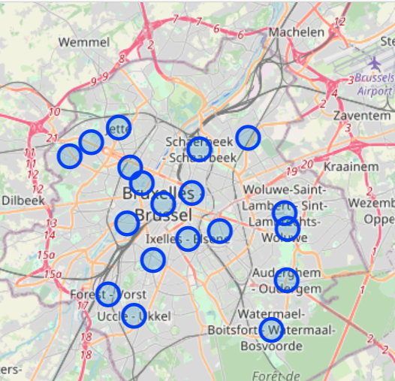
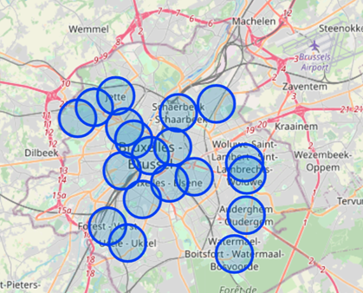
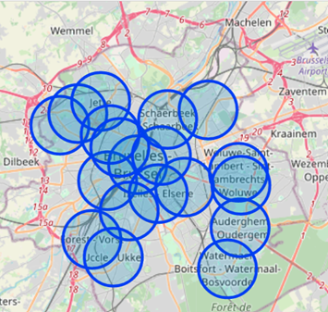
Methodology
We can visualize the consequences of the circle radius choice when displaying maps using different circle radius: 500 meters, 1000 meters and 1500 meters.
If the radius is small, circles are not overlapping a lot but it is a drawback for bigger municipalities as only a reduced area is covert.
If the radius is big, a huge overlapping occurs for smaller municipalities which leads to the under-differentiation of clusters.
circle radius of 500 meters
circle radius of 1000 meters
circle radius of 1500 meters

Slide 14


Methodology
It appears that the usage of a circle to determine an area is not suitable for most of the municipalities of Brussels. The possible solution here might have been to divide municipalities in smaller groups of similar size and form and apply different circle radius parameters to different groups and merge results together.
The radius finally chosen for this project was 1000 meters - the map from the middle - as a compromise between less areas overlapping and best territorial coverage.

Slide 15

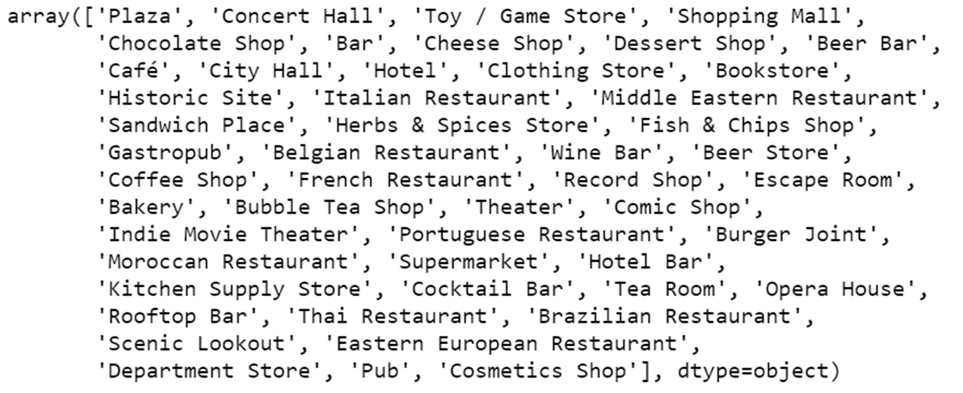
Methodology
The Foursquare API has been used to explore the municipalities and segment them. The term neighborhood will be used instead of municipality from this point on.
I started by exploring the first neighborhood in neighborhoods dataframe. It returned ‘Anderlecht’ neighborhood. Then I got the top 100 venues that are in ‘Anderlecht’ within a radius of 1000 meters.
Afterwards the same method has been applied to get all the neighborhoods (municipalities) in Brussels-Capital and put them in a new dataframe called ‘brussels_venues’.
There were 243 unique categories found. See below examples of categories.

Slide 16
Methodology
The next step was to use the one-hot encoding technique that converts categorical values into dummies necessary for machine learning.
Then I clustered neighborhoods using Machine Learning technique, namely k-means. I chose to work with 4 clusters. Ideally, the number of clusters should have been determined by the appropriate method. The most known methods being “elbow”, “silhouette” and “gap statistics”.
Finally I visualized the resulting clusters on the map using Folium and proceeded with clusters exploration.
I examined each cluster and determined the discriminating venue categories that distinguish each cluster. Based on the defining categories, I made some general recommendations for expats so they can choose which neighborhoods best meet their expectations for settling themselves in Brussels for living and working.

Slide 17
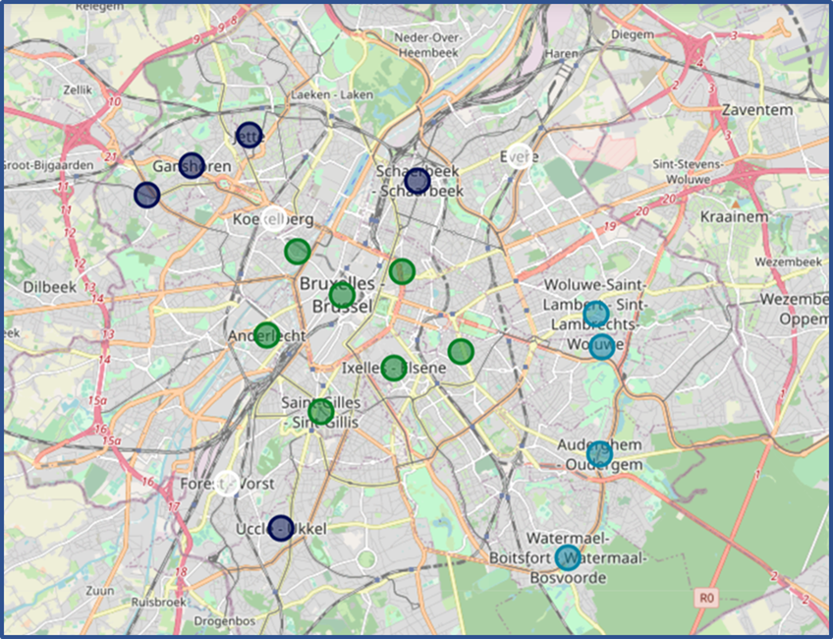
Results
The clustering process returned 4 clusters of different sizes. For each cluster we display 10 most common venues per neighborhood so we can explore them. We select the cluster using ‘Cluster Labels’ that range from 0 to 3.
The first cluster - green marker - has 7 municipalities.
The second cluster - indigo marker - has 5 municipalities.
The third cluster - blue marker - has 4 municipalities.
The fourth cluster - white marker - has 3 municipalities.

Slide 18

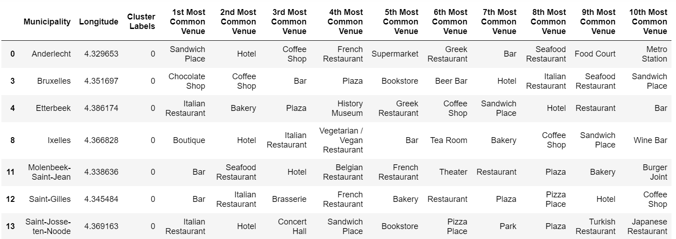
Results
The first cluster (cluster label 0) (green marker) has 7 municipalities.

Slide 19
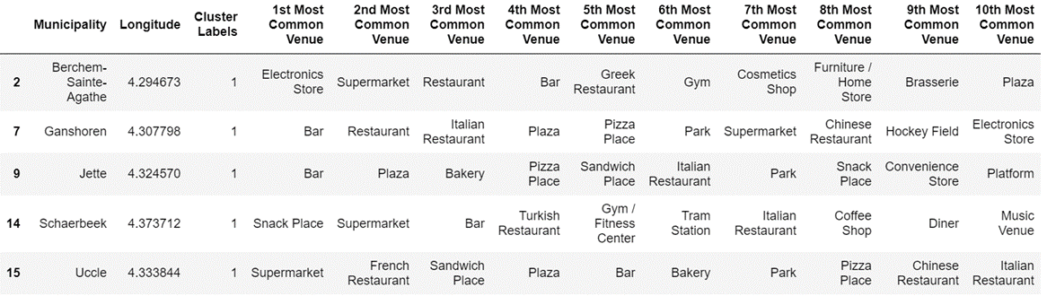
Results
The second cluster (cluster label 1) (indigo marker) has 5 municipalities.

Slide 20
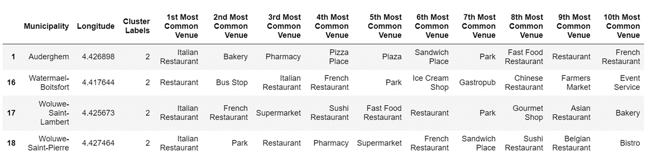
Results
The third cluster (cluster label 2) (blue marker) has 4 municipalities.

Slide 21
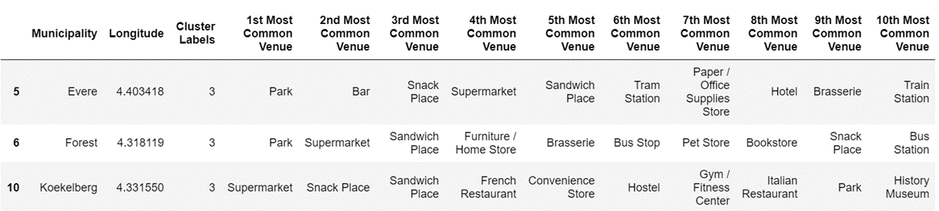
Results
The fourth cluster (cluster label 3) (white marker) has 3 municipalities.

Slide 22
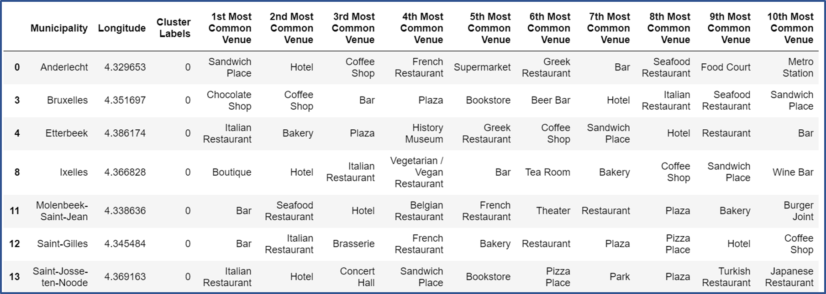
Discussion - The First Cluster (green markers)
All municipalities from this cluster are regrouped in the center or near the center of Brussels. They are adjacent one to another. With its 7 municipalities it is the largest cluster.
We notice that the most common venues are restaurants serving dishes from all over the world, bars, fast-foods and hotels. It suggests lively urban areas and the presence of many touristes.
Recommandation: These kinds of places might be attractive to younger expats, singles or couples without children enjoying to go out and have fun with friends after their work, without having to do long distances to get there.

Slide 23
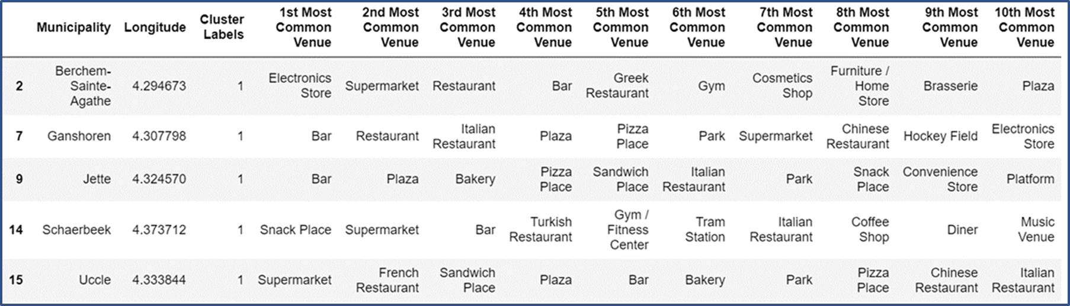
Discussion - The Second Cluster (indigo markers)
The majority of municipalities from this cluster - 4 of them - are located outside the center, in the northern part of Brussels. They are adjacent one to another. One municipality being located outside as well but at the extreme southern part and not adjacent to others.
We count less restaurants and bars than in the first cluster and we start to have among the most common venues parks, gyms and even a hockey field. Supermarkets are also present.
Recommandation: The municipalities from this cluster being located outside the center and well equipped for day to day life suggest that they are better suited for expats families with children.

Slide 24
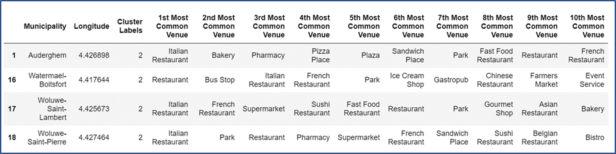
Discussion - The Third Cluster (blue markers)
All municipalities from this cluster are located outside the center and close to The Sonian Forest at the southeast edge of Brussels. They are adjacent one to another.
The most common venues are parks and all kinds of restaurants. There are also bakeries, pharmacies, supermarkets and even an ice cream shop.
Recommandation: These municipalities are very well suited for expats who enjoy green areas and value the near presence of the large forest where they can go walking or biking after work.

Slide 25
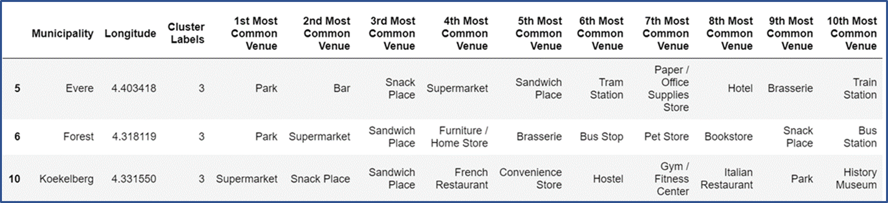
Discussion - The Fourth Cluster (white markers)
All 3 municipalities from this cluster are spread from nord to south and are not adjacent one to each other.
The most common venues are supermarkets and fast-foods.
Recommandation: It is difficult to distinguish dominating characteristics here and furthermore give any general recommendations.

Slide 26
Conclusion
After exploring all clusters, there is a question that comes to mind: to what extent the Foursquare application is suitable to solve the problem we are trying to address in this project, namely, give recommendations about the best place for living for the expats arriving for work in Brussels based on their expectations?
Foursquare contains a lot of valuable information gathered from application’s users about places they have visited. It concerns mainly the best places to go out, to do shopping, to do sports. In the project we take into account 10 most common venues for each of 19 municipalities and we notice that restaurants of all kinds as well as bars, coffee shops and fast-foods are among the most visited venues. The predominance of food and drink related places limits the interest of clustering based on 10 most common venues to solve the problem stated in this project.
Nevertheless, we ended up with 4 clusters, from which 3 were well differentiated and allowed us to give some recommendations for expats coming to Brussels for work.

